Slide 1

iPhone Sales Forecast
Operation Analysis Prof. Weiwei Chen
AAKASH BHATT
SAI RONITH REDDY BONGUNOORI
MYTHILI RAJARAM
MANVIKA SHARMA
ABHISHEK TEGGINAMAT

Slide 2

Introduction
In this project we work on sales forecasting which analyzes previous data to anticipate future sales, enabling more informed decisions. We use iPhone 11 pro dataset of three different models recorded over three years, divided into quarters. Each quarter's dataset includes the quantity sold, selling price, discount, and revenue generated. Our goal is to provide accurate inventory forecasts for the coming quarters.

Slide 3
Methodologies
Data Cleaning
Linear Regression Model
Deseasonalization
Adjusting Seasonal Forecasts

Slide 4
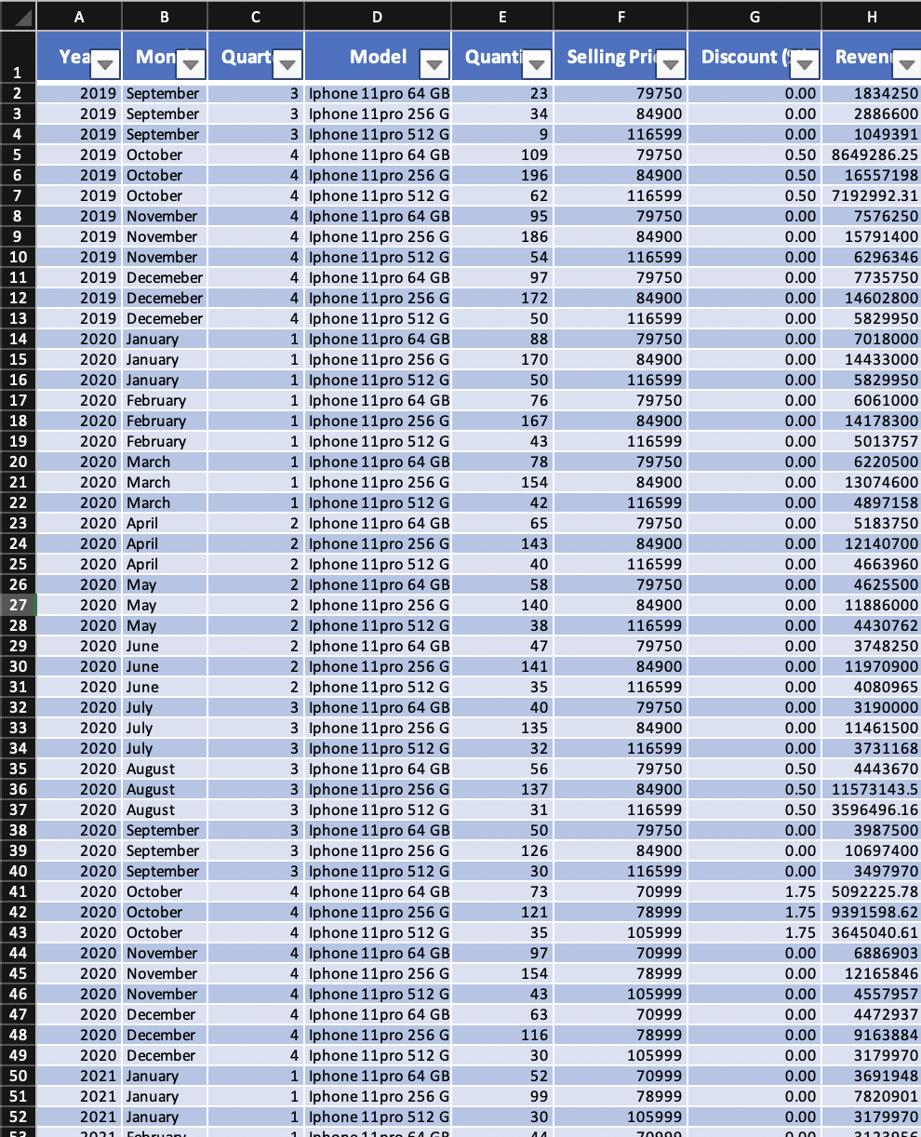
Data Cleaning
We start with basic data cleaning and remove columns like X, Y, and Z. Further, we divide the data into three worksheets for different models and run the calculations separately. We then begin with the second period because the first period is just a short number of days, and we may encounter outliers in the model if we include it.

Slide 5
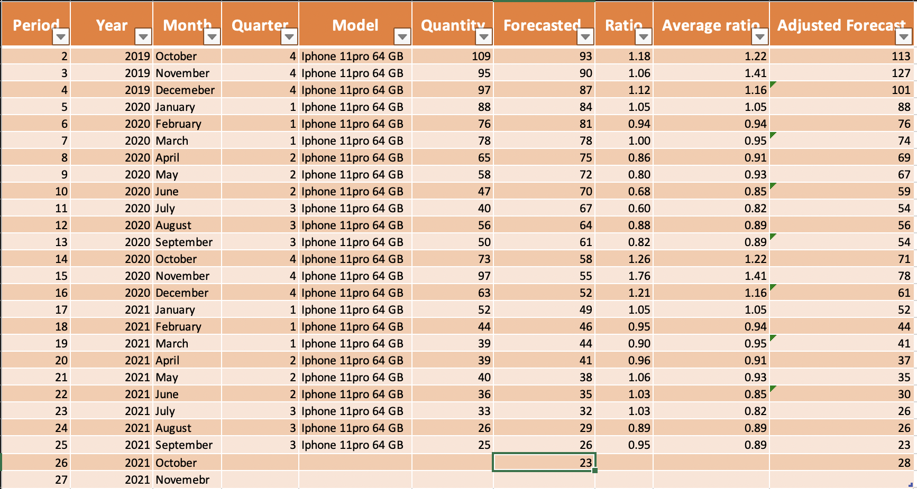
Linear Regression
We work on this model by calculating the basic average, the company forecasted stock gains for the next quarters. Exponential Smoothing and Moving Average lags behind the trend, resulting in large differences between estimates and real data. Smoothing models do not work since the data is not stationary, has a trend or seasonality to it. We run the linear regression model on the dataset to get the forecasted value for a better prediction.

Slide 6
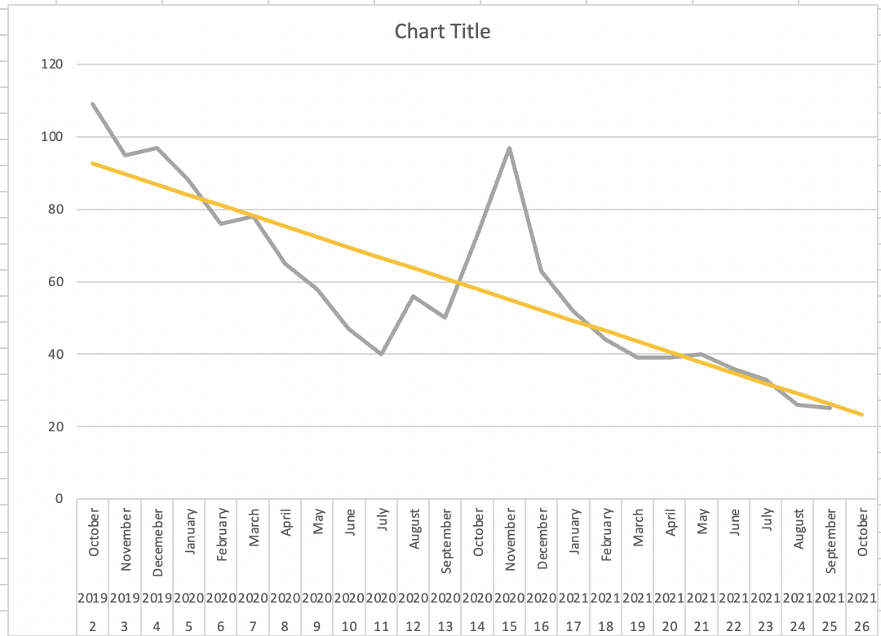
Deseasonalization
The process of removing seasonality from a data series by identifying the seasons and computing each period index. We restore seasonality by multiplying each forecast of the changed time series by the relevant period index to create the required forecasts for the original seasonal time series. We then apply the methods which assumes no seasonality but changes the data to account for it.

Slide 7
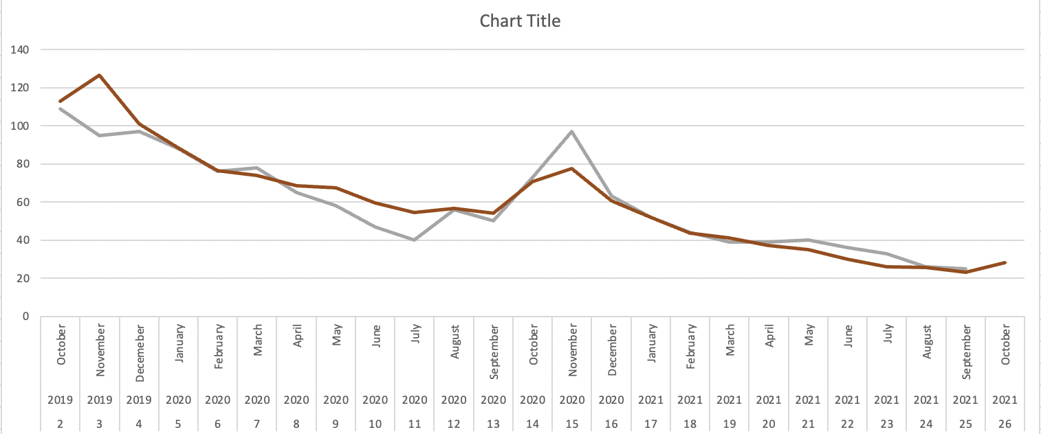
Adjusting Seasonal Forecast
The period index or average ratio is calculated for each month. We then compute the Seasonally Adjusted Forecast = Unadjusted Forecast x Period Index(average ratio). In the graph,we can see that the grey line is the actual forecast and the red line gives the adjusted forecast. The same procedure is followed for 2 other models as well, i.e. for the 256gb and 512gb.

Slide 8

Conclusion
Seasonal patterns are removed from time-series data in our study. The company utilized to forecast stock gains for the coming quarters by using the basic average. We now have seasonally adjusted or deseasonalized data, which has been cleansed of its seasonal patterns. The company can estimate better and more accurate forecasts to stock up supplies using this strategy and the resulting prediction.

Slide 9


